Slide 1
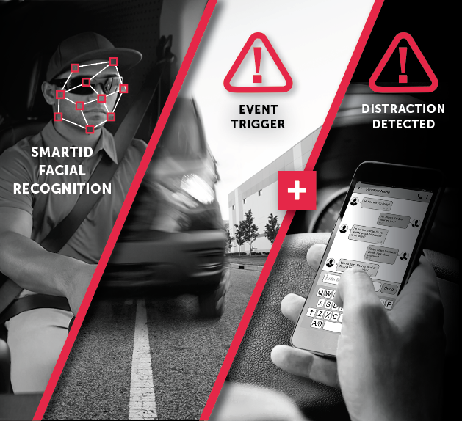
AI TECH
SOFTWARE SOLUTIONS
AI CAPABILITIES WITHOUT AI CAMERA COSTS
The SmartWitness AI Tech Package uses SmartID facial recognition to assign telematics data to drivers and CARE (Computer Analyzed Risk Evaluation) — a cloud-based machine vision AI algorithm that specifies whether distraction and/or fatigue were at the root cause of device-triggered events.
AI TECH BENEFITS
Works with existing 4G, non-AI SmartWitness cameras
Helps your customers save time and money
Provides accurate reporting instantaneously
Delivers a confidence score as part of the analyzed video output
SAVES THE AVERAGE FLEET $10K IN NEW CAMERA COSTS*
*Based on the average purchase price of new AI cameras and an estimated fleet size of 18 vehicles.
Notes:
1. SmartID: Recognizes driver facial features and immediately assigns and aligns trip data with drivers vs. vehicles. This solution provides more accurate reporting and event tracking without any additional hardware, key fobs or driver ID codes.
2. CARE (Computer Analyzed Risk Evaluation): Determines if fatigue or distraction was involved in triggered driving events. This solution empowers fleet managers to better hone their focus on critical events.

